Slide 1
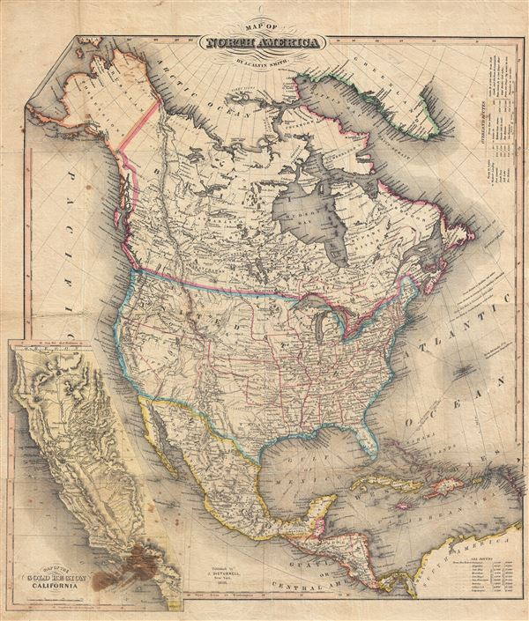
New World Beginnings
33,000 B.C. – A.D. 1769

Slide 2
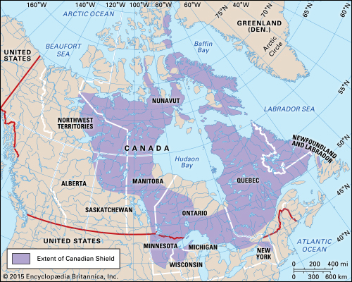
The Shaping of North America
The Canadian Shield
The 1st part of North America to emerge above sea level.
Assisted in creating the geography of North America.
The Land Bridge theory
End of Ice Age diminished glaciers over North America.
Land Bridge emerged linking Asia & NA across Bering Sea.
People walked across the "bridge" before the sea level rose
The Land Bridge occurred around 35,000 years ago.

Slide 3
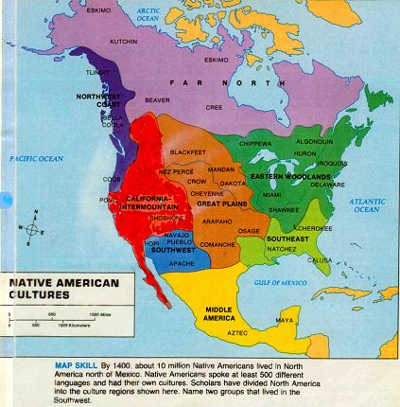
The First Americans
“Perhaps” 54 million people inhabited the two American continents.
The Native Tribes
Groups spread across North, Central, and South America.
Tribes emerged with an estimated 2,000 languages. Notably:
Incas: Peru, with elaborate network of roads and bridges linking their empire.
Mayas: Yucatan Peninsula, with their step pyramids.
Aztecs: Mexico, with step pyramids and huge sacrifices of conquered peoples.

Slide 4
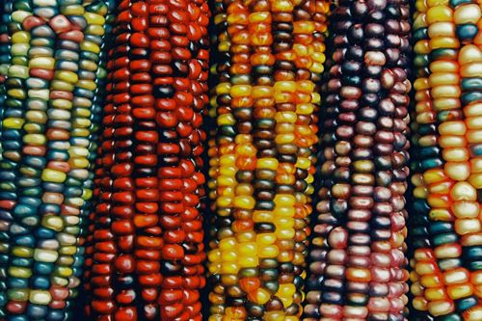
CORN
Development of corn or maize around 5,000 B.C. in Mexico was revolutionary in that:
Didn't have to be hunter-gatherers, could settle down and be farmers.
Began to establish permanent settlements
No large concentration of pop. like in SA or Mesoamerica
Scattered pop. allowed Europeans to defeat Native Americans easier
Corn arrived in the present day U.S. around 1,200 B.C.

Slide 5
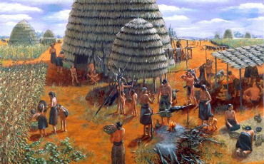
The Native American Life…
Native Americans had different view of things as compared to Europeans.
Native Americans-no man owned the land, the tribe did. (Europeans- private property)
Indians- nature was mixed with many spirits. (Europeans-Christian and monotheistic)
Indians- nature was sacred. (Europeans- nature and land to be subdued and put to use).
Indians- little or no concept or interest in money. (Europeans- loved money or gold)

Slide 6
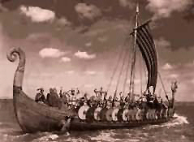
Europeans Arrive in America…
The 1st Europeans to come to America were the Norse (Vikings from Norway).
1000 AD, the Vikings landed in Newfoundland (L’Anse aux Meadows)
No strong nation- state to support other voyages, settlements abandoned
Columbus
Convinced King and Queen of Spain to finance expedition to bypass Africa route to Asia
1492 “discovers” America
Voyage eventually leads to the beginnings of a global system
Europe would provide the market, capital, technology.
Africa would provide the labor.
The New World would provide the raw materials (gold, soil, lumber).

Slide 7
The Columbian Exchange
From the New World (America) to the Old
corn, potatoes, tobacco, beans, peppers, manioc, pumpkin, squash, tomato, wild rice, etc. also, syphilis
From the Old World to the New
cows, pigs, horses, wheat, sugar cane, apples, cabbage, citrus, carrots, Kentucky bluegrass, etc.
devastating diseases (smallpox, yellow fever, malaria), as Indians had no immunities.
The Indians had no immunities in their systems built up over generations.
An estimated 90% of all pre-Columbus Indians died, mostly due to disease.

Slide 8
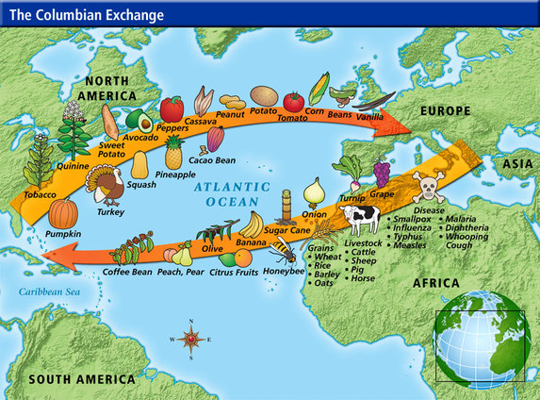

Slide 9
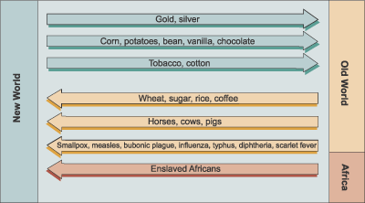

Slide 10
Spanish Conquistadores
Spain secured claim to Americas from Treaty of Tordesillas (1494)
1500’s dominant explorers/ colonizers of Americas
Conquistadors explored and conquered much of N & S America
I. Led to a flood of silver from SA, Mexico caused inflation in Europe
Led to rise of capitalism and commercial banking, paid for international trade
II. Encomienda system established
Indians "commended“ or given to Spanish landlords
The idea was that Indians would work and be converted to Christianity, but it was basically just slavery on a sugar plantation guised as missionary work.

Slide 11
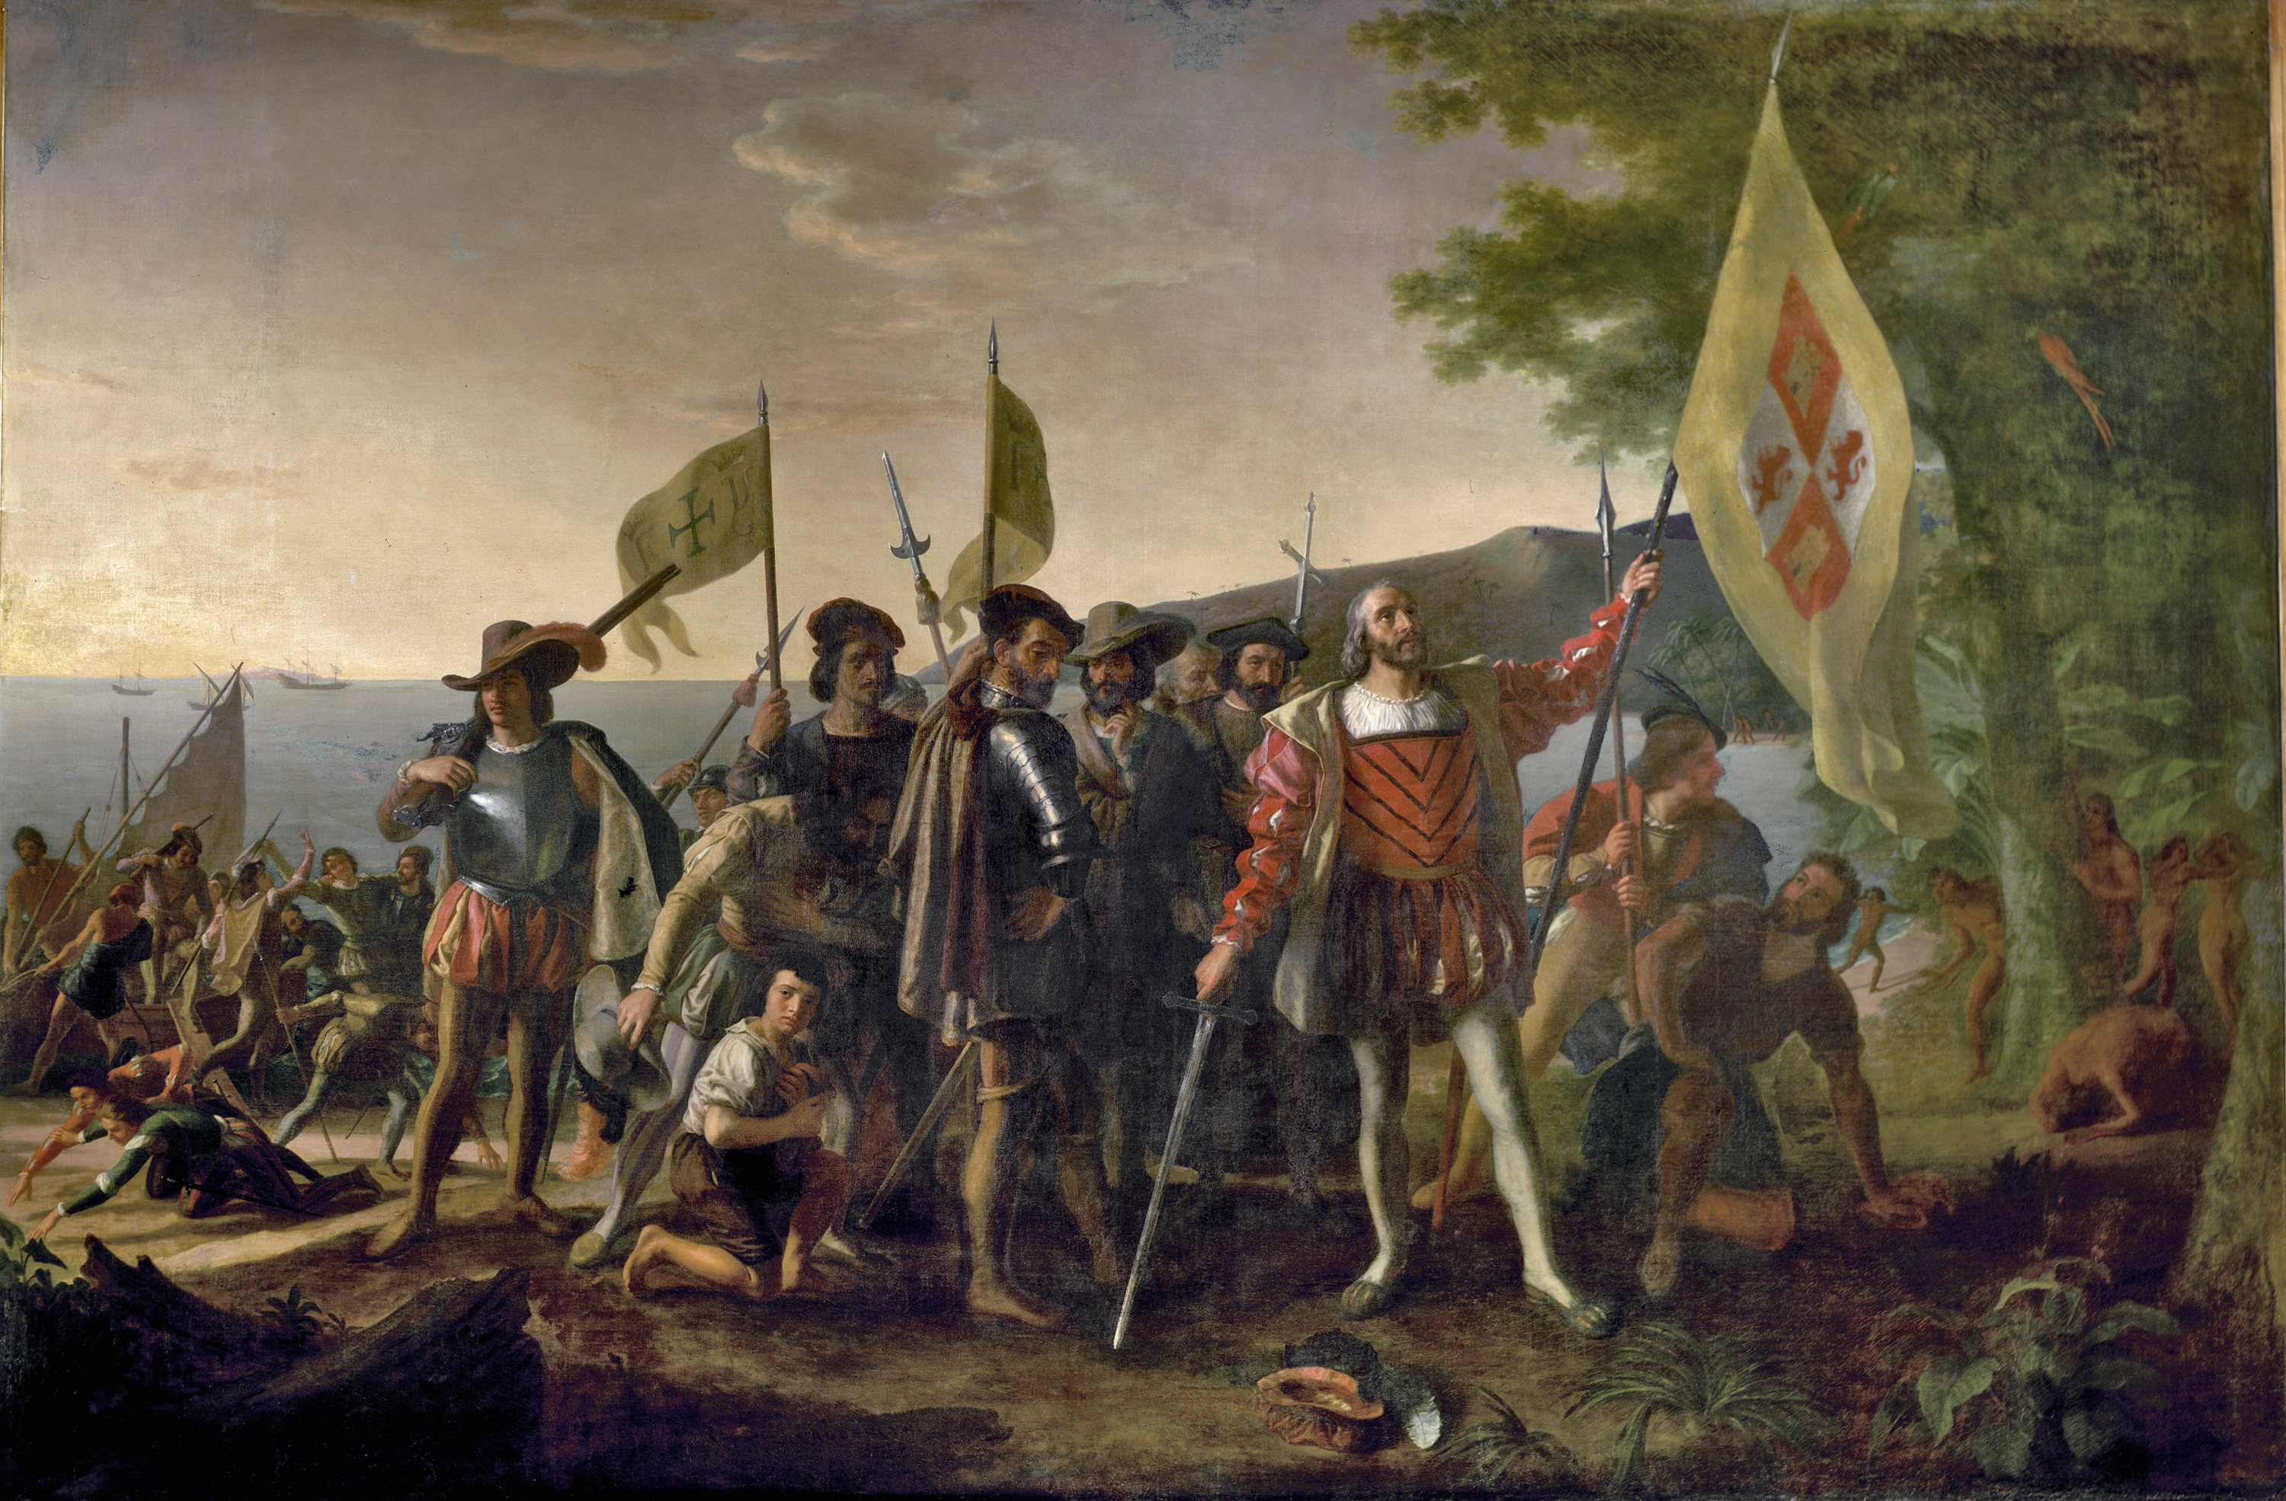

Slide 12
The Spread of Spanish America
Spain’s empire grew quickly
Threats from other European powers- English, French
Spanish set up forts (presidios) to protect borders- from Florida to California
Rebellions in New Mexico against Spanish (Pope’s Rebellion 1680)
Black Legend: The Black Legend was the notion that Spaniards only brought bad things (murder, disease, slavery); though true, they also brought good things such as law systems, architecture, Christianity, language, civilization, so that the Black Legend is partly, but not entirely, accurate.

Slide 13
