Slide 1
Colonial Society on the Eve of Revolution
1700 – 1775
Chapter 5 – American Pageant

Slide 2
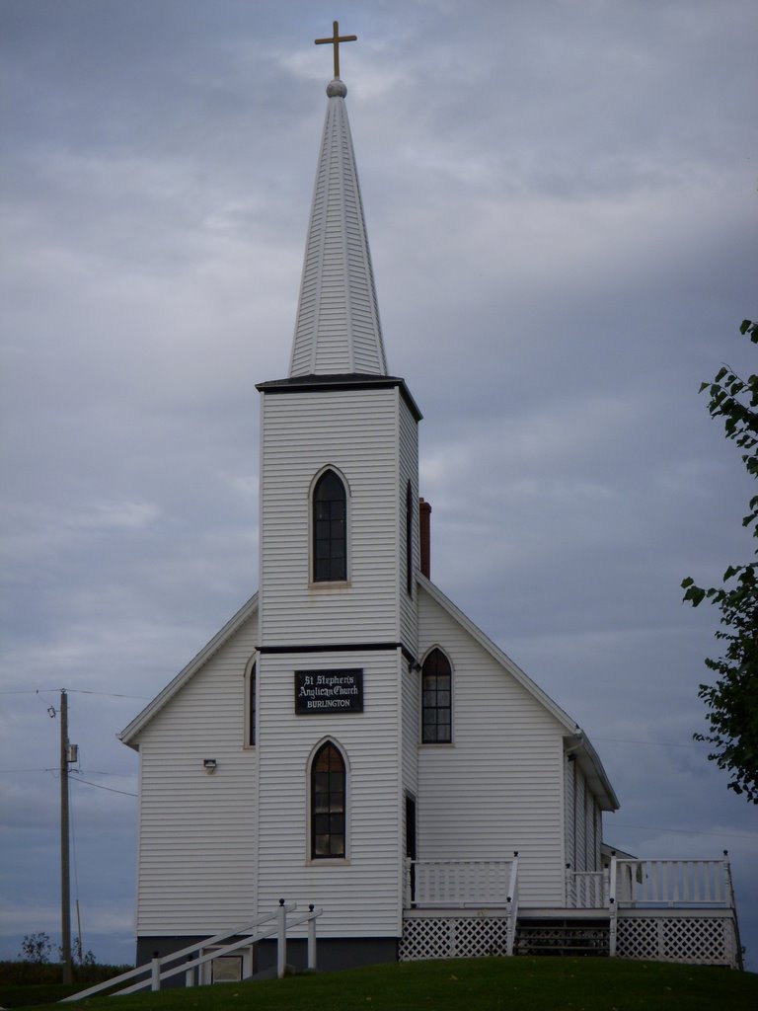
Dominant Denominations
2 “Established” churches:
Anglican
Georgia, North & South Carolina, Virginia, Maryland, part of New York.
Served as king’s authority.
Less fierce and more worldy than Puritan views.
College of William & Mary founded to train clerics.
Supported the king.
Congregational
Grew out of Puritan church
All New England colonies except Rhode Island.
“Sedition” flowed free from the pulpits.
Presbyterianism, Congregationalism & rebellion became a neo-trinity.
A large majority of population surprisingly didn’t attend any form of worship.

Slide 3
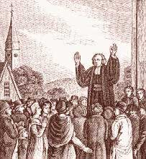
A Great Awakening – Why?
Liberal ideas were beginning to challenge the old time religion.
“dead dogs”
Souls were no longer kindled by the hellfire of orthodox Calvanism.
Arminians
Dutch theologian Jacocobus Arminius
Individual free will determined a person’s eternal fate.
2 factors (intellectualism and liberalism) were “sapping” the spiritual vitality from many denominations.

Slide 4
The Great Awakening!
“Old Lights”
Orthodox clergymen
Very skeptical of the emotionalism and theatrics of the revivalists.
“New Lights”
Ministers that defended the Awakening for its role in revitalizing American religion.
1730’s – 1740’s
Swept through the colonies like “a fire through the prairie grass”.
Northampton, Mass – Jonathan Edwards
Salvation through good works and affirmed need for complete dependence on God’s Grace
Sinners in the Hands of an Angry God
Hell was “paved with the skulls of unbaptized children.”
George Whitefield
Human helplessness & divine omnipotence.
Brought many, including B. Franklin to tears.
His style inspired many imitators.
Effects of the Great Awakening:
Undermined the older clergy
It created the number and the competitiveness of churches
Encouraged a fresh wave of missionary work
1st spontaneous mass movement of American people!!

Slide 5
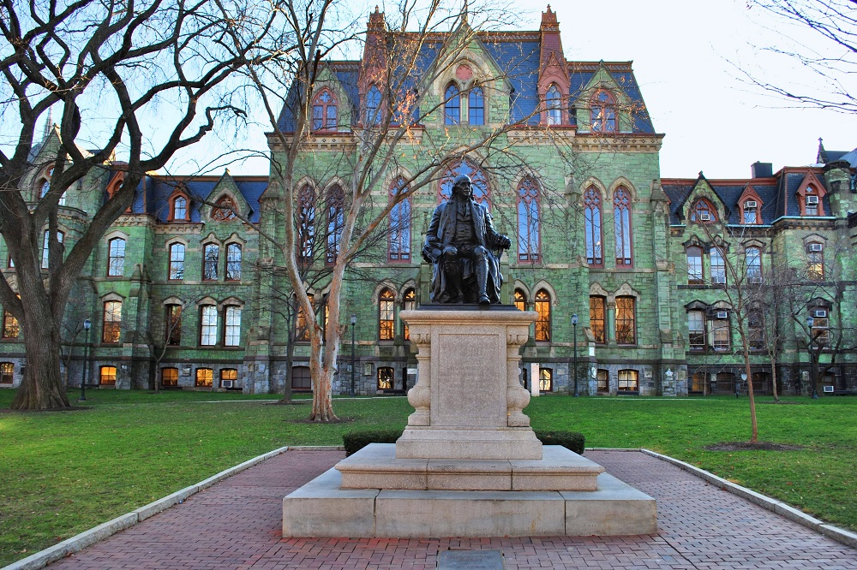
Schools & Colleges
The colonies “slowly & painfully” broke the chains of ancient educational restrictions.
Puritan New England – most interested in education!
Primary goal = make good Christians rather than good citizens = reading the Bible!
Mainly for boys
Inadequate “scholars” caused many to send their children to Europe for education or have them privately tutored.
Focus = Religion, Latin & Greek
9 colleges created during the colonial era.
Ben Franklin assisted in founding the University of Pennsylvania = 1st free from denominational control!

Slide 6
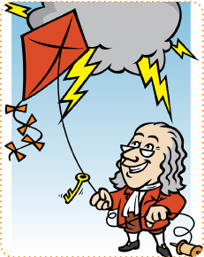
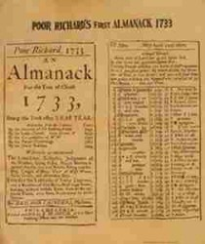
A Provincial Culture
Still enjoyed European tastes in regards to culture, i.e. arts, architecture…
Architecture – modifed to meet the climate and religious conditions of the New World but were largely imported from the Old World.
Log Cabins – Sweden! Who Knew! ☺
Many inspiring artists were discouraged in pioneer life and moved back to Europe to continue their passions.
Ben Franklin – very, very impressive man!!
“1st civilized American”
Poor Richard’s Almanac
“kite-flying experiment”
Bifocles
Franklin stove

Slide 7
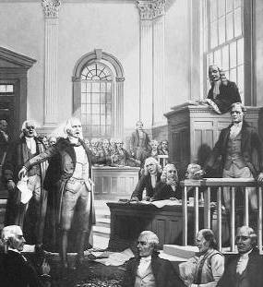
Pioneer Press
Americans were mostly “too poor” or “too busy” to read!
B. Franklin = first privately circulating library, which led to other public libraries.
Pamphlets, leaflets, and journals were printed by hand-operated printing presses.
News Lagged!!!
Many weeks behind
29 days later Charleston found out about the DofI!
The Zenger Case – 1734-1735
Banner of achievement for freedom of the press & health of democracy!

Slide 8
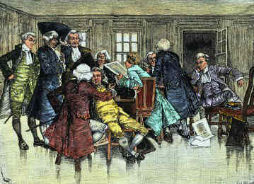
The great game of politics
Local Governments
County – plantation south
Town meetings – New England
Combo – Middle (surprise)
Voting Qualifications
Privileged upper class
Religious & property qualifications
½ males unable to vote.
Those who could mostly didn’t!
Had others handle political matters
1775
8 royal governors
3 under proprietors that chose the governor
2 elected their own governor under self-governing charters
2 house legislative body
Upper House - Council
Lower House – Popular Branch
Self-Taxation through representation was a “precious privilege”
Lord Cornbury – enough said!
Colonial assemblies would hold pay of governors to assert their authority.
London government = poor administration!
Democratic Seeds!!
Tolerance
Educational advantages
Equality of economic opportunity
Freedom of speech, press & assembly
Representative governments

Slide 9
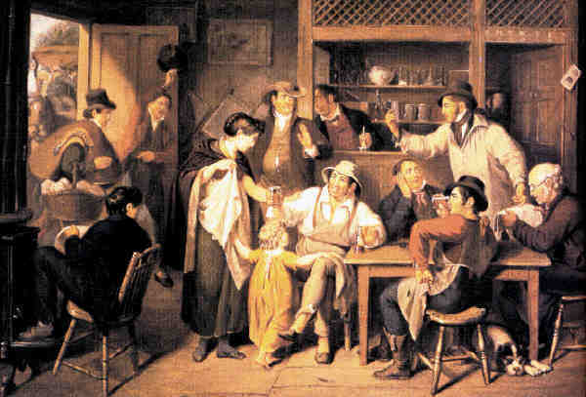
Colonial folkways
Shared History, Culture, & geography set the stage for independence!!
“drab” & “tedious” – labor was heavy & constant
Food = plentiful
Basic European comforts lacked.
Hogs & buzzards assisted with the “waste”.
Amusement?
Militia, aka “musters” – drills mixed with merrymaking & flirting
House-raisings, quilting-bees, …..
Sports
North – winter sports
South – card playing, horse racing, …..
Lotteries were approved
Plays were looked down upon by clergy…. Could be in a religious lecture instead.
Holidays!! Except Christmas ☹

