Slide 1
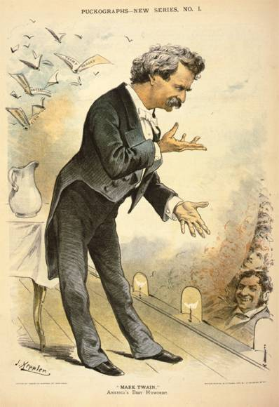
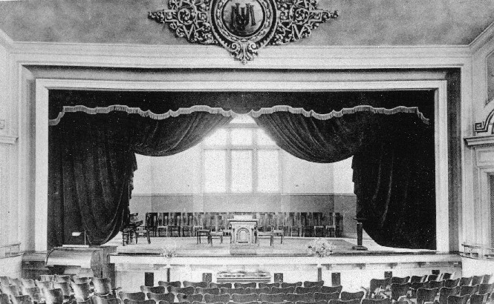
Social & Cultural Trends
Section 5.3

Slide 2
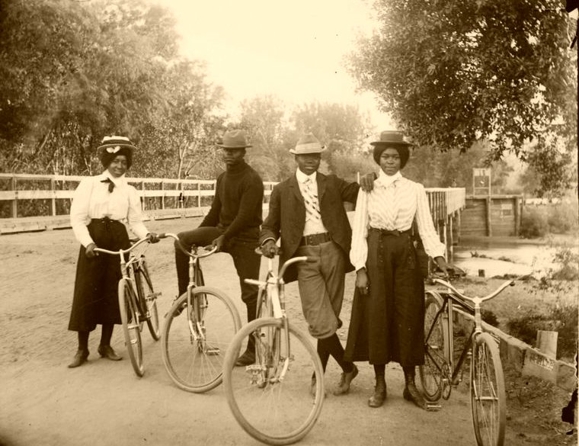
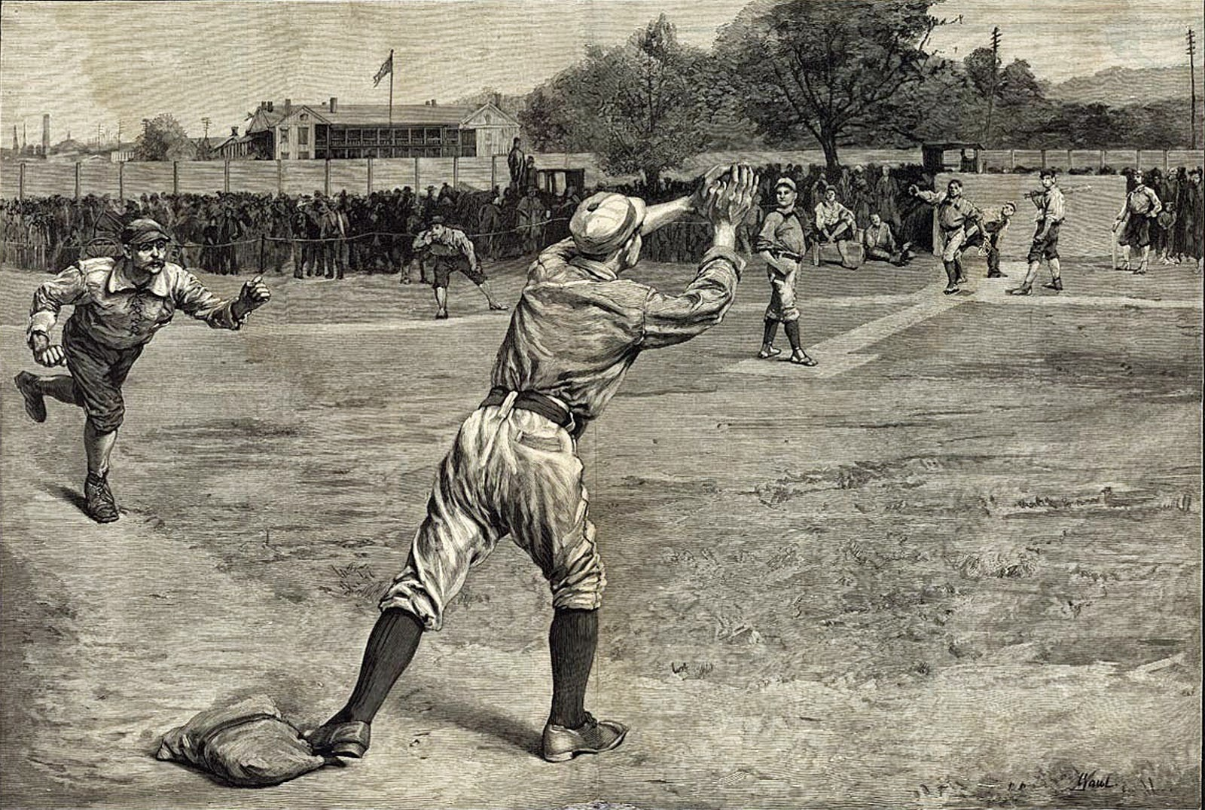
Key Terms
Mark Twain
Gilded Age
Conspicuous consumerism
Mass culture
Joseph Pulitzer
William Randolph Hearst
Horatio Alger
Vauderville
Objectives
Explain how new types of stores and marketing changed American life.
Analyze the ways in which Americans developed a mass culture.
Describe the new forms of popular entertainment in the late 1800’s.

Slide 3
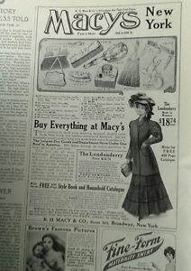
Americans become Consumers
Conspicuous Consumerism – people wanted and bought the many new products on the market.
1858 – Rowland H. Macy opened the first Macy’s department store.
Largest single store in America at the time
Widspread advertising, a variety of goods organized into “departments”, and high-quality items at a fair price.
John Wanamaker
First to offer a money back guarantee
Placed large newspaper advertisements to attract customers
Later became postmaster general and made it easy for mail order catalog businesses by lowering bulk shipping rates and free delivery to rural areas.

Slide 4
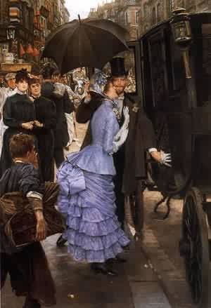
Standards of Living
“The Victorian Era”
The rich were richer than ever before and the middle class tried to imitate their lifestyle.
Post Civil War, Americans measured success by what they could by.
Better sanitation and medical care contributed to better health = higher life expectancy
Indoor Plumbing!
Men became commuters
Leaving early and coming home late to live in the suburbs
American culture – hard work will pay off!

Slide 5
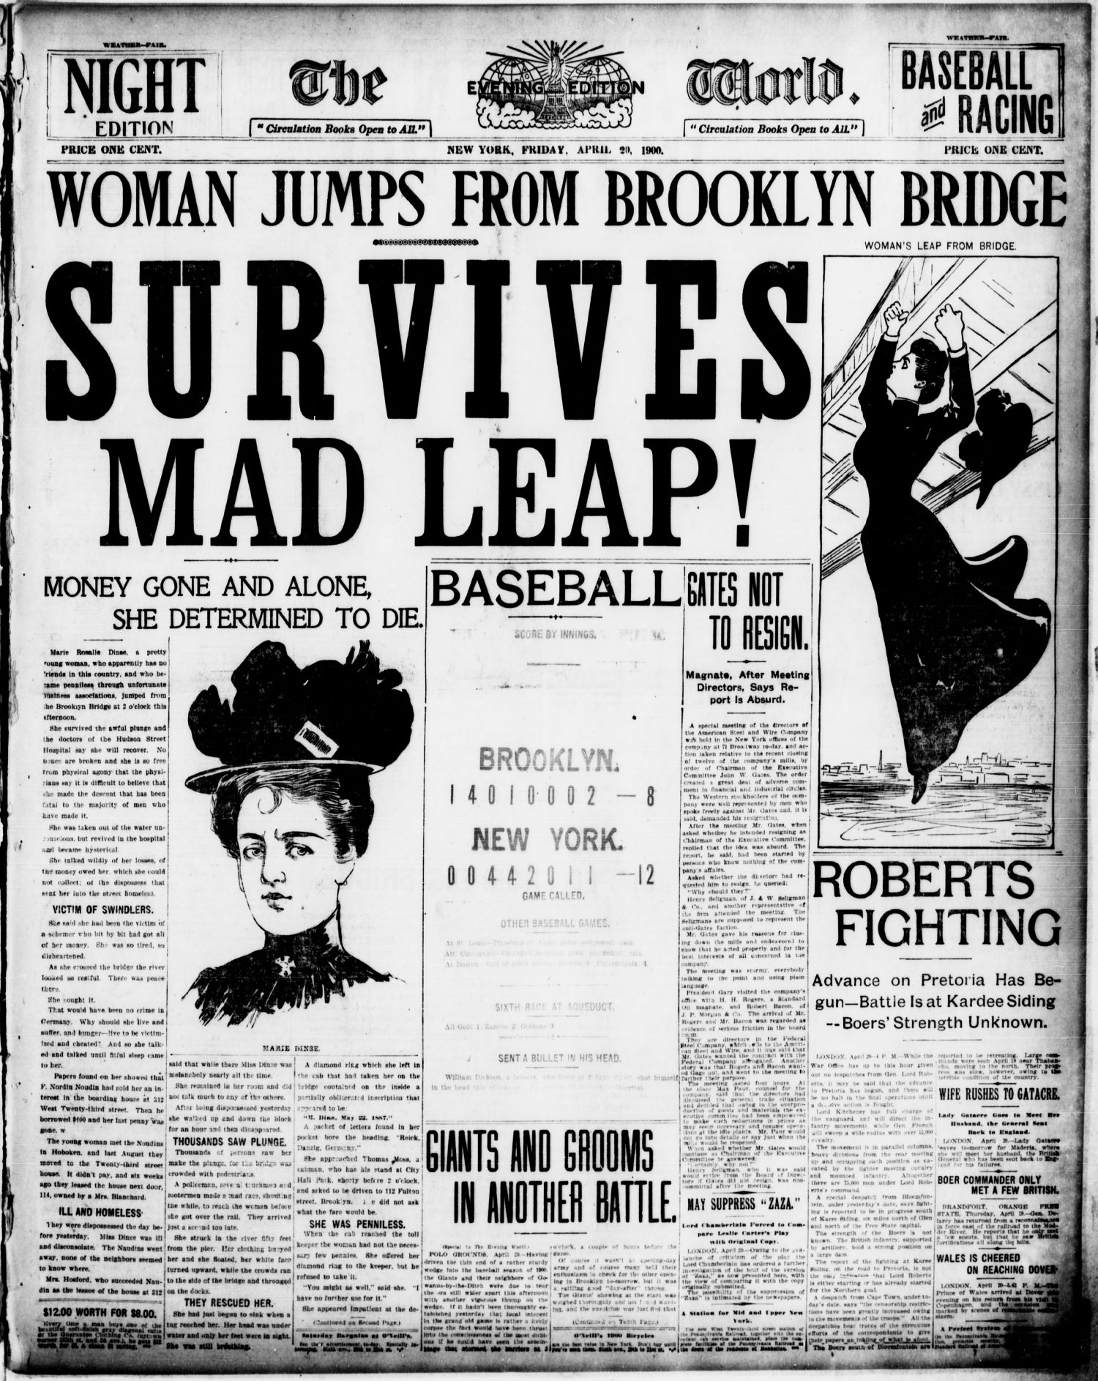
Mass Culture
Transportation, Communication, & Advertising brought all Americans together culturally in their consumption patterns.
Newspapers
Helped create mass culture
1870-1900 – papers increased from 600 to 1,600
Joseph Pulitzer
The World & The Evening World
Believed it was the newspapers job to inform people and to stir up controversy
Papers were considered sensationalistic
Filled with exposes of political corruption, comics, sports, and illustration
William Randolph Hearst – becomes Pulitzer’s rival
The Philadephia Tribune – African American newspaper
New York – six Italian papers by 1910.
Sold more than 10,000 copies daily.

Slide 6
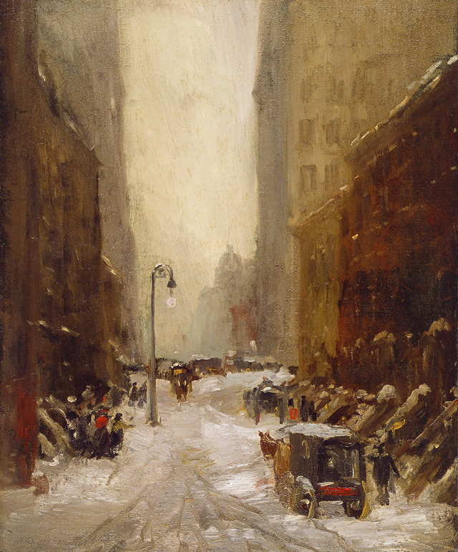
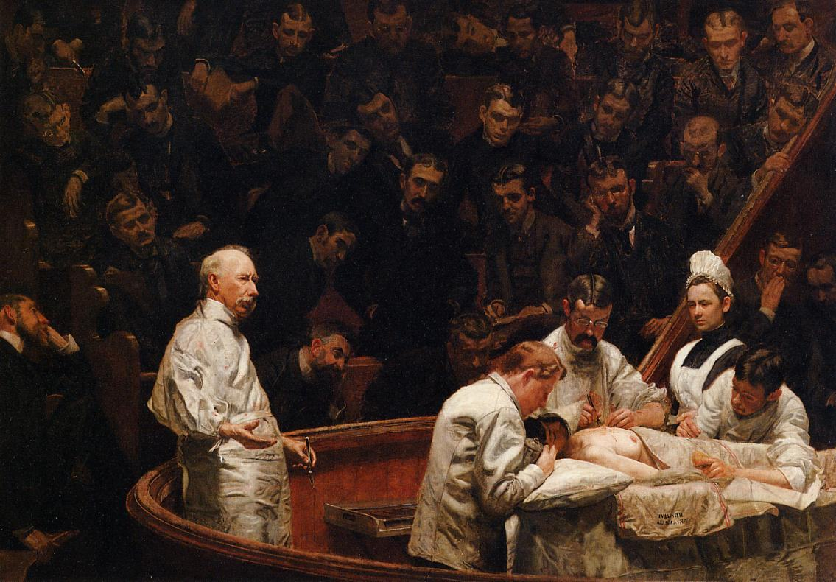
Literature & the Arts
Mark Twain – The Gilded Age
Stephen Crane – Maggie: A Girl of the Streets & The Red Badge of Courage
Exposed the slums of New York
Horatio Alger – wrote about characters who succeeded by hard work
Henry James & Edith Wharton – questions a society based upon rigid rules of conduct.
Playwright John Augustin Daly mirrored Twain’s disapproval of the Gilded Age.
Thomas Eakins – painted a larger than life illustration of a medical operation
Robert Henri – developed a style of painting known as the Ashcan School.
Dramatized the starkness and squalor of New York slums and street life.

Slide 7
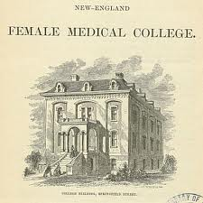
Education
Public education rapidly expanded during the Gilded Age.
Grade school became compulsory
Many cities had high schools, although few attended.
1880 – few hundred
1910 – more than 5,000
Kindergartens were created for working-class mothers.
Literacy rate in the US climbed to nearly 90% by 1900!
Higher education
Liberal arts curriculum designed
Women’s colleges emerged
Limited access was granted to African Americans at white schools.

Slide 8
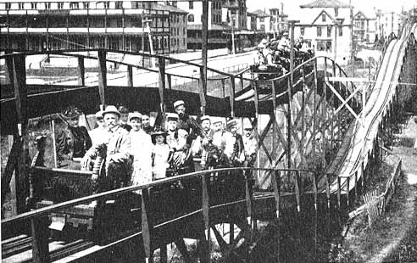
Popular Entertainment!
Exhibitions
Showed New technologies & entertainment
Stretched Americans’ imaginations
“future filled with machines and gadgets.
Amusement Parks
1884 – First rollercoaster
Invented by Lamarcus Thompson
Ten cents a ride/+$600.00 a day
Coney Island – nation’s best known
Ethnic groups were divided at many parks
Day long vacation for urban dwellers who couldn’t afford longer vacations.
City Life
Glitzy shows
Vaudeville – shows that were a medley of musical drama, songs, and off-color comedy.
Chains across the country by 1900.
Nickelodeons
Movie theaters
5 cent admission
The Great Train Robbery
Music Halls

Slide 9
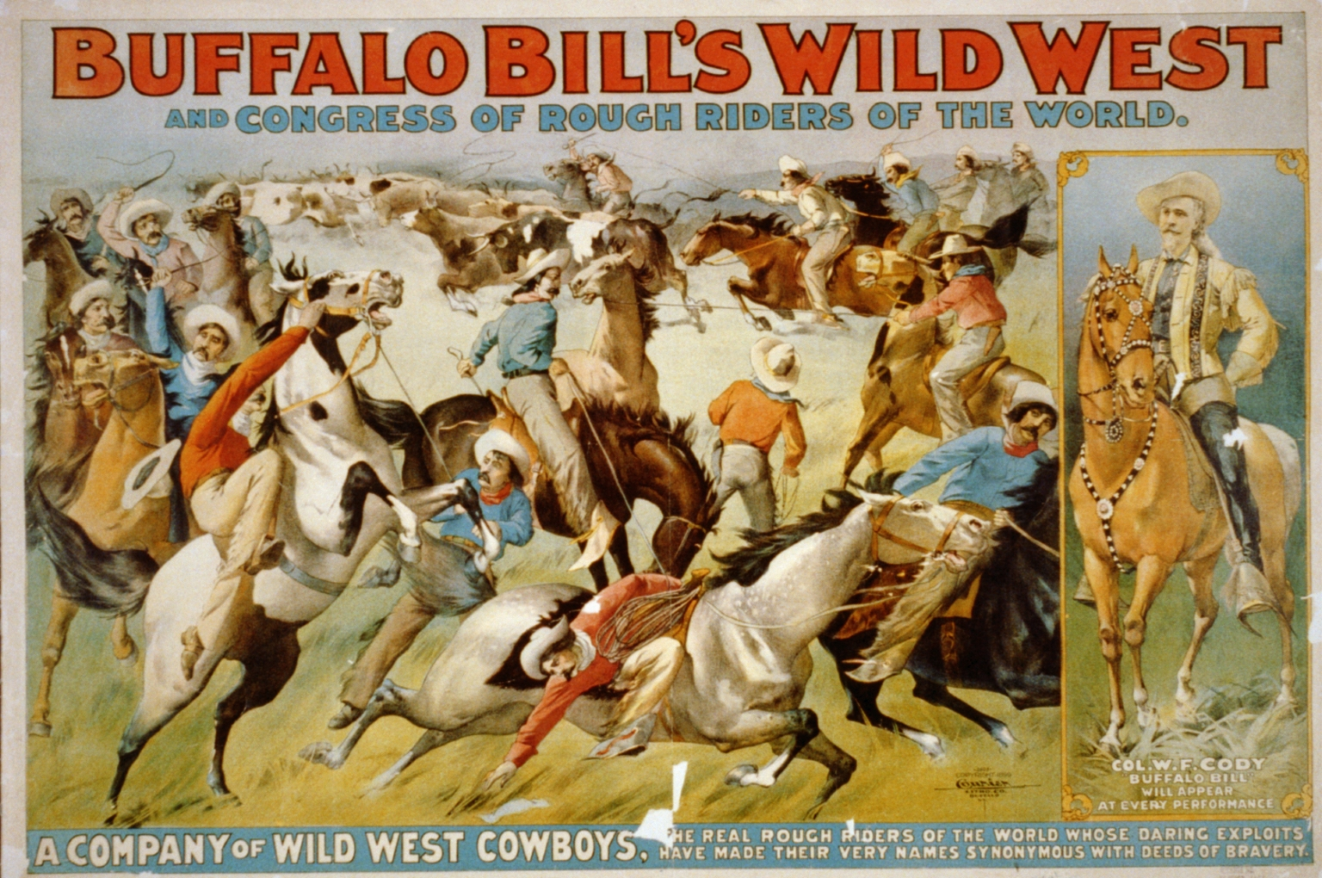
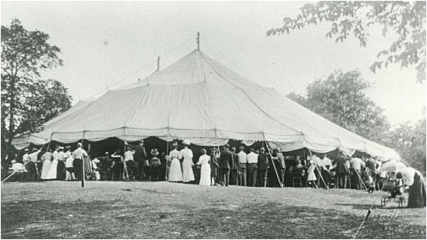
Outdoor Events
1884 - Chautauqua Circuit
Summer camp that sponsored lectures & entertainment.
Began as a summer school for Methodist Sunday school teachings.
Moved to cities using tents and became a place for people to see motion pictures .
1883 – Buffalo Bills 4th of July Celebration
Buffalo Bill’s Wild West Show
Toured America & Europe
Romantic Notion of West
Annie Oakley & Sitting Bull
Sports
Baseball: America’s national sport
Organized into National League in 1876.
Until 1887 African Americans played…. Started their own league in 2900
Horse Racing, Bicycle Racing, Boxing, Football, & Basketball

