Slide 1
Psychology’s Big Issues & Approaches
Module 2

Slide 2
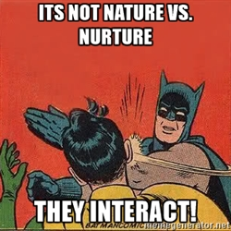
Objectives
Summarize the nature-nurture debate in psychology.
Describe psychology’s three main levels of analysis and related perspectives.
Identify psychology’s main subfields.

Slide 3
Nature vs. Nurture
Nurture Viewpoints
Nature Viewpoints
Plato
Assumed we inherit character and intelligence
Certain ideas are inborn
Locke
Blank slate theory
Aristotle
There is nothing in the mind that does not first come in from the external world through the senses.
Descartes
Some ideas are inate
Darwin
Nature selects traits that best enable an organism to survive and reproduce in a particular environment.
“natural selection”
Biology’s organizing principal
Also focused on animal behaviors.
*how are humans alike?
*Are gender differences important?
*How are intelligence & personality differences influenced by heredity and by environment?
Nurture works on what nature endows

Slide 4
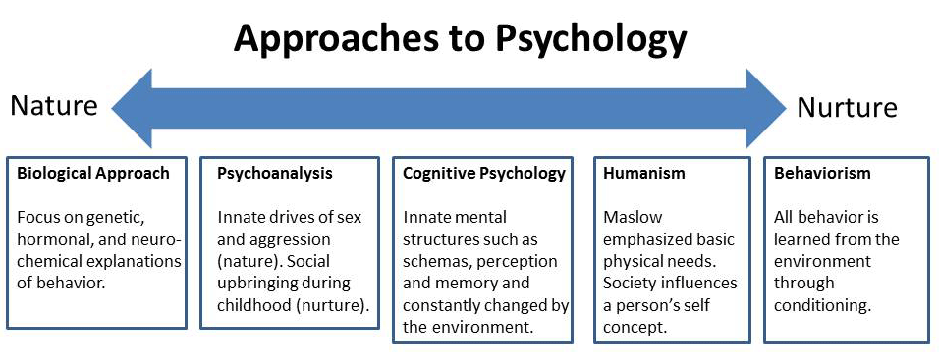

Slide 5
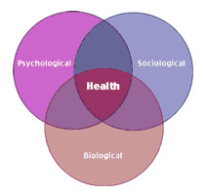
3 Main levels of Analysis
The Biopsychological Approach:
Biological
Psychological
Social – Cultural
*Levels of Analysis – offer complementary outlooks using the biopsychological approach.
Each level provides a valuable vantage point but by themselves is incomplete.
Each have their own questions and limits

Slide 6
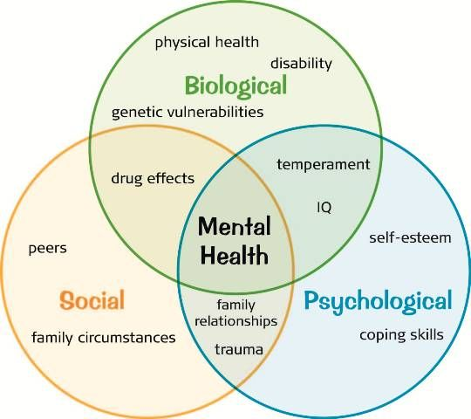

Slide 7
Psychology’s Subfields & Other good Info
“Cluster of subfields” – meeting ground for different disciplines united by the common quest – Describing and explaining behavior and the mind and underlying it.
Psychometrics – field designed to study the measurement of our abilities, attitudes, and traits.
What Psychology Does:
Psychology influences modern culture!
Knowledge transforms us and modified our attitudes and behaviors.
Psychology does have limits!
Psychology deepens our appreciation for how we perceive, think, feel, and act.
It enriches our lives and enlarges our visions.
“Books are the quietest and most constant of friends, and the most patient of teachers” – Charles Elliot

Slide 8
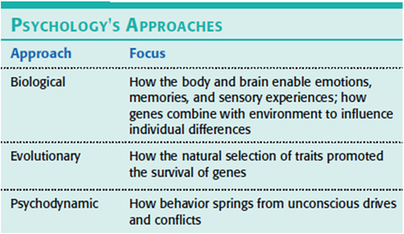

Slide 9
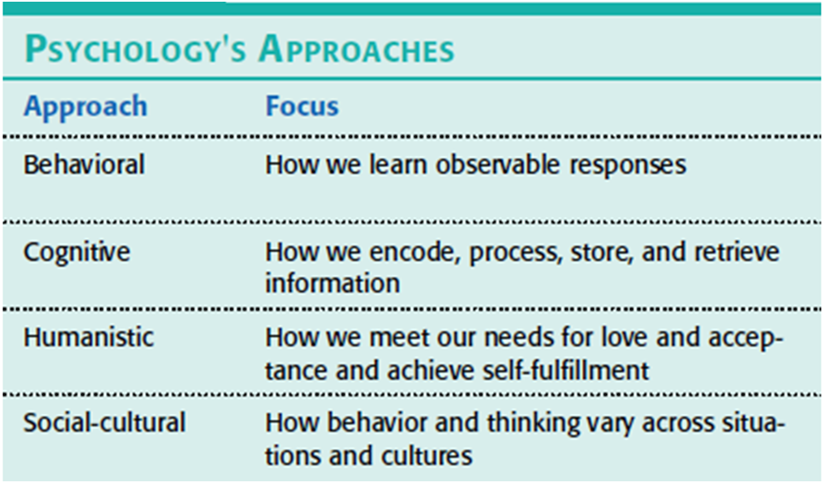

Slide 10
