Slide 1
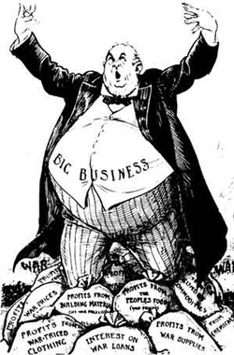
Chapter 4 ; Section 2
The Triumph of Industry
1865-1914

Slide 2
The Rise of Big Business
Key Terms & People
Objectives
Corporation
Monopoly
Cartel
John D. Rockefeller
Horizontal integration
Trust
Andrew Carnegie
Vertical integration
Social Darwinism
ICC
Sherman Antitrust Act
Analyze different methods that businesses used to increase their profits.
Describe the public debate over the impact of big business.
Explain how the government took steps to block abuses of corporate power.

Slide 3
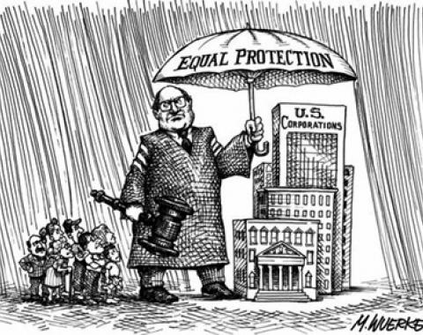
The Corporation Develops
Corporation – A number of people share the ownership of a business.
Advantages:
Perfect solution to the challenge of expanding businesses. Ex. Railroads/mining
Same rights as an individual:
Buy and sell property
Sue in courts
Had huge access to invested money (capital)
Ability to operate in several different regions due to railroads and telegraphs.
1870 = # of corporations increased dramatically!

Slide 4
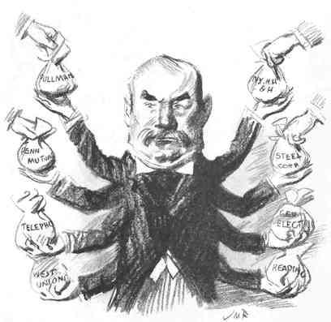
Gaining a Competitive Edge
Maximizing corporation profits:
Decreased the cost of producing goods
Paid lowest possible wages
Paid lost cost for raw materials
Increased profits by advertising their products widely
Increased their customer base.
Monopoly – Corporations gaining complete control of a product or service.
Buy out competitors
Drive competitors out of business
Cartel – Corporations worked to eliminate competition by forming arrangements to limit their productions on the same product and thus keep

Slide 5
Horizontal & Vertical Integration
Horizontal Integration
Businessmen create a giant company with lower production costs.
Consolidated many firms in the same business.
Trust – Companies assign their stock to a board of trustees, who combine them into a new organization that they run and pay themselves from the dividends on profits.
Vertical Integration
Businessmen gain control of the many different businesses that make up all phases of a product’s development.
Allowed companies to reduce costs and chafe higher prices to competitors.

Slide 6
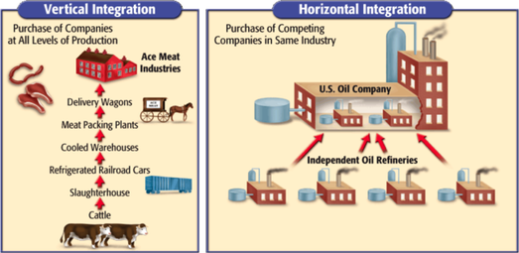

Slide 7
“Robber Barons” or “Captains of Industry”?
Captains of Industry
Robber Barons
Provided jobs for an ever-growing labor force.
Developed efficient business practices.
Supported developing technology
Benefited nation’s economy
Stimulated innovation
Philanthropists
Established universities, museums & libraries.
Made it possible for the disadvantaged to rise to wealth.
Trusts, Cartels, & Monopolies gave powerful businessmen an unfair advantage.
Small businesses were squeezed out by competition.
Small businesses joined trusts that payed small profits.
Consumers were unfairly harmed by high prices on products.
Considered to “swindle the poor.”

Slide 8
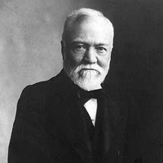
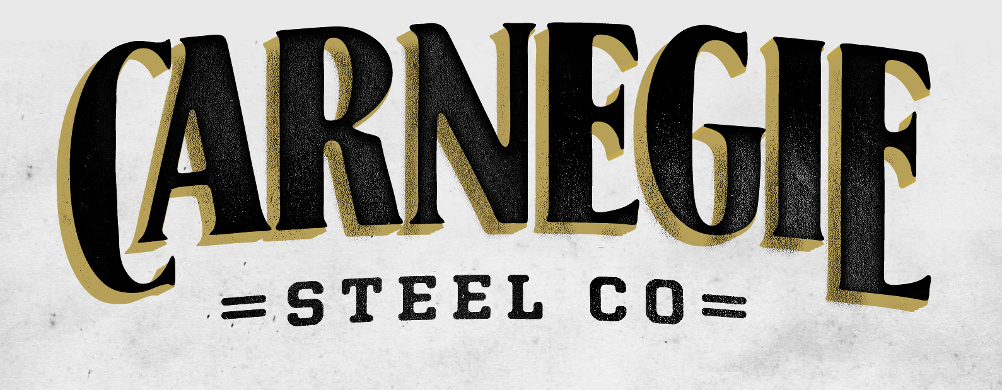
Andrew Carnegie

Slide 9
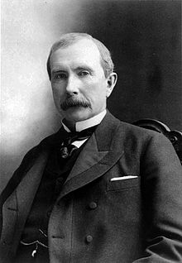
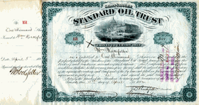
John D. Rockefeller

Slide 10
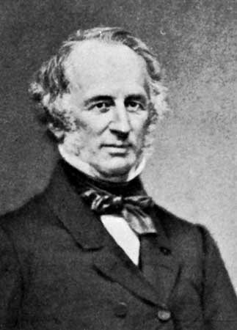
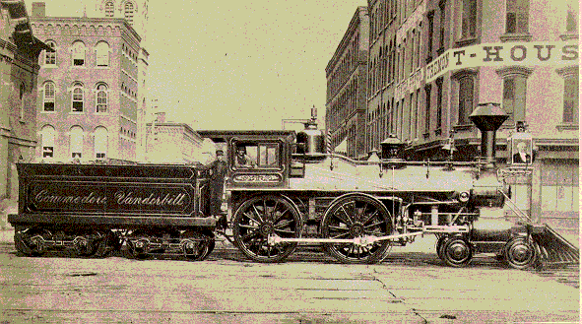
Cornelius Vanderbilt

Slide 11
Social Darwinism Catches On
1859 – Charles Darwin writes The Origin of Species.
Animals evolved by a process of “natural selection”
Only the fittest survived to reproduce.
William Graham Sumner applied Darwin’s theory to American capitalism.
Social Darwinism – Wealth was a measure of one’s inherent value and those who had it were the most “fit”.
The government should stay out of private businesses - would disrupt natural selection.
The nation would grow strong by allowing its most vigorous members to rise to the top.
Fueled Discrimination!
Pointed to the poverty-stricken condition of many minorities as evidence of their unfitness.

Slide 12
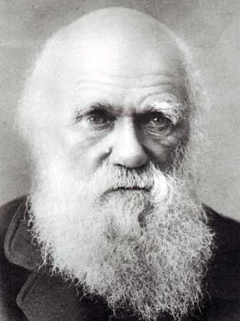

Slide 13
The Government Imposes Regulations
1887 - US Senate creates the ICC ( Interstate Commerce Commission)
Oversee corrupt railroad operations.
1st federal body ever set up to monitor businesses.
Could only monitor railroads that crossed state lines
Required railroads to send in their records to Congress.
1890 – Sherman Antitrust Act
Outlawed any trust that operated “in restraint of trade or commerce among the several states”.
Seldom Enforced
Often used in the corporation’s favor by arguing that labor unions restrained trade.
These acts began a trend toward federal limitations on corporations’ power.

Slide 14
