Slide 1
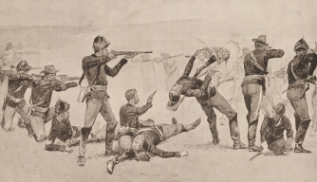
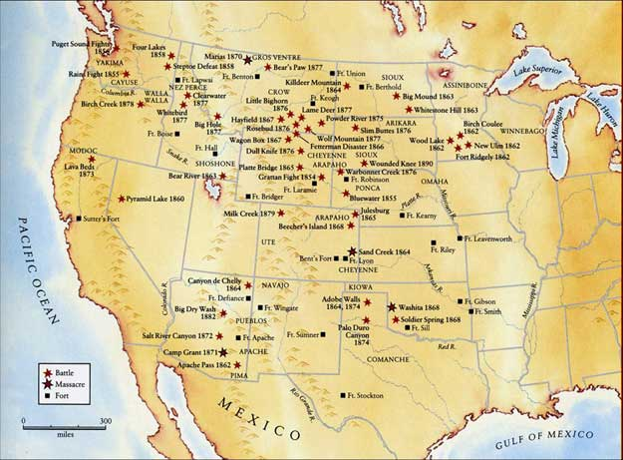
The South & West Transformed
1865-1900
Chapter 6

Slide 2
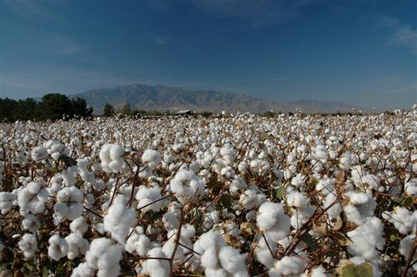
6.1 The New South
Key Terms
Cash Crop
Farmers’ Alliance
Civil Rights Act of 1875
Objectives
Explain how the southern economy changed in the late 1800’s.
Analyze how southern farmers consolidated their political power
Describe the experience of African Americans in the changing South.

Slide 3
Industries & Cities Grow
Railroads:
*Important key to industrialization.
1880’s – 2 rail lines linked South to North:
Texas to Chicago
Tennessee to D.C.
*Prison labor helped build Southern rail lines.
Limited Economic Growth
Industry rests on 3 things:
Natural Resources
Labor
Capital Investment
(South only had 1st!)
Limited education
Lacked technical & engineering schools
Low wages discouraged skilled workers
Higher wages elsewhere took Southern workers.
Banks – wealth was concentrated in the hands of a few people following the War.
Southerners were often dependent on Northern banks.
Southern Industry
Growth
Raw Materials
Cotton
Wood
Iron Ore
Northern Banks backed textile, cigar, & lumber industries in the South
Coal, Iron, & Steel processing created urban centers
Nashville
Birmingham
Agriculture!
Grain
Tobacco
Fruit
Small farms replaced plantations!
Lack of Labor & Capital hurt the South!!

Slide 4
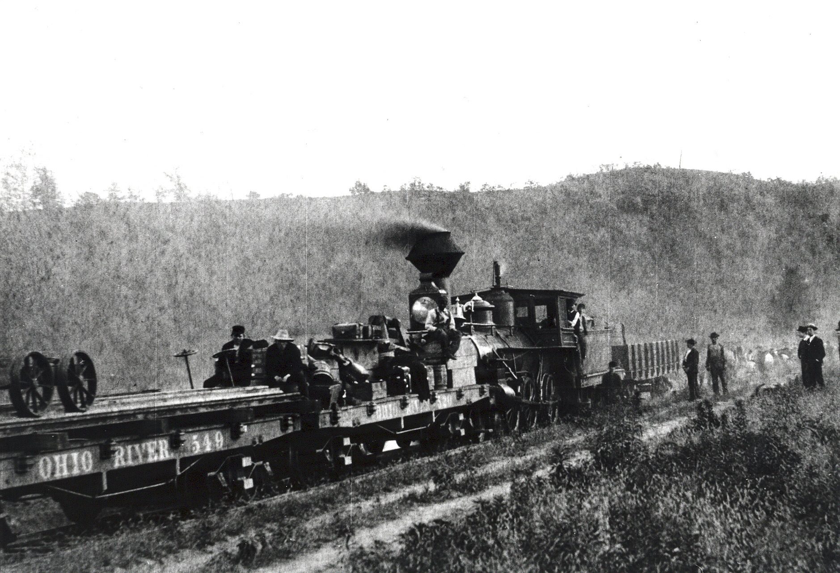

Slide 5
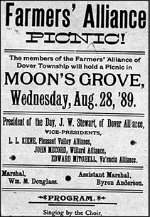
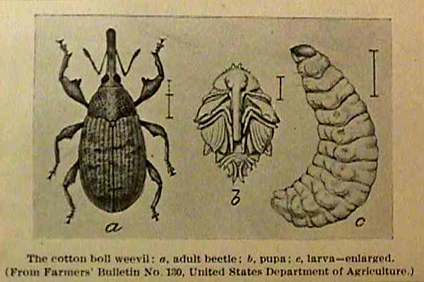
Southern Farmers Face Hard Times
Cotton Dominates Agricultures
Cotton = Souths #1 crop
Surplus – after the war when Europeans had found other sources. This caused the price to fall.
Boll Weevil
First appeared in Texas
Destroyed cotton crops, causing the appeal for American cotton to once again rise.
Farmers Band Together
The Farmers’ Alliance
Formed by Texas farmers in the 1870’s that began to organize & negotiate for lower prices for supplies.
Constantly lobbying the government to force railroads to lower freight prices & to regulate the interest that banks could charge for loans.

Slide 6
Black Southerners Gain & Lose
White Backlash Begins
Political & Economic Gains
Ku Klux Klan
Terror & violence against African Americans.
Segregation of churches.
New laws supposed the elimination of black government officials.
Access to Education
Basic-literacy schools & teachers’ colleges were established for African Americans.
Right to vote in local & federal elections.
Ability to serve in government & military.
Businesses & farms for African American increased
Farmers Alliance
Civil Rights Acts of 1875
Guaranteed black patrons the right to ride trains & use public facilities, such as hotels.
Enforcement became left to the states…..

Slide 7
6.2 Westward Expansion & the American Indians
Objectives
Key Terms
Compare the ways Native Americans and white settlers viewed and used the land.
Describe the conflicts between white settlers and Indians.
Evaluate the impact of the Indian Wars.
Reservation
Sand Creek Massacre
Sitting Bull
Battle of the Little Big Horn
Chief Joseph
Wounded Knee
Assimilate
Dawes General Allotment Act

Slide 8
The Native Cultures
Geography influenced the cultural diversities but they shared one common idea: They were part of nature & viewed nature as sacred.
Pacific Northwest
Klamaths, Chinooks, & Shastas
Fish& forest animals
South
Small bands of hunter gatherers
Small game, berries, nuts, …..
New Mexico & Arizona
Pueblos
Irrigated the land to grow corn, beans, & squash
Adobe homes high in the cliffs
Navajos
Mobile!
Homes made of mud or in hogans that could be easily moved.
Plains Indians
Sioux, Blackfeet, Crows, Cheyenne & Camanche
Expert horsemen & hunters
Buffalo!

Slide 9
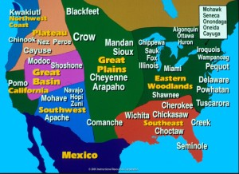

Slide 10
The Gradual move to Reservations
Diseases, the loss of the Buffalo & settlers moving West were the 3 biggest problems for Natives!
Early 1800’s
Trail of Tears begins with Andrew Jackson
Moved to “The Great American Desert”
1834 – trade regulated between Natives &
“whites” strictly limited from Native lands.
1850’s
Gold & Silver
Railroads
Scientist claiming arid land would be good for crops moved more settlers West.
1851 – Restrictions on Natives to smaller areas in the West
Late 1860’s – Reservations are established.

Slide 11
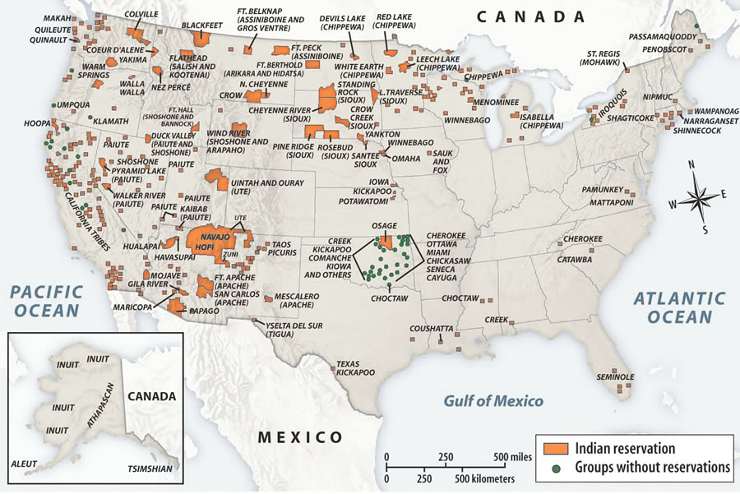

Slide 12
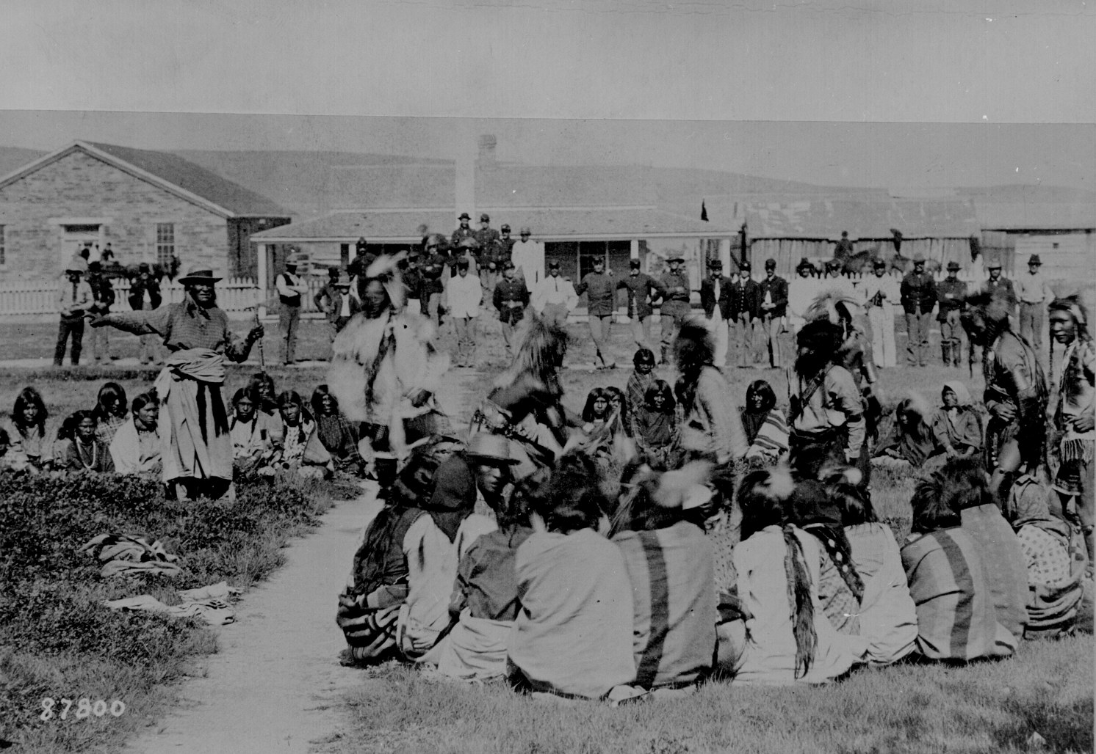

Slide 13
Native & American battles during the Civil War
1862 – Sioux resisted threats to their land by attacking settlements in Minnesota.
RESULT: Government issued a full scale war against the Sioux and pushed them into the Dakotas.
This sparked a series of attacks on settlements & stagecoach lines.
1864 – Sand Creek Massacre
Colorado Militia attacked an unarmed camp of Cheyenne & Arapaho Indians that were under US protection.
Commander John Chivington was scorned for this attack on protected Indians.
This causes another series of warfare of Plains Indians joined to rebel against white settlements.

Slide 14
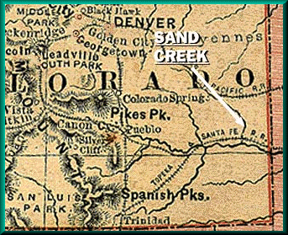
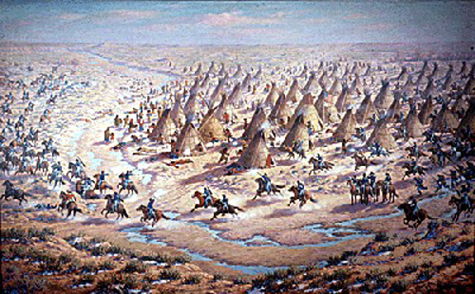

Slide 15
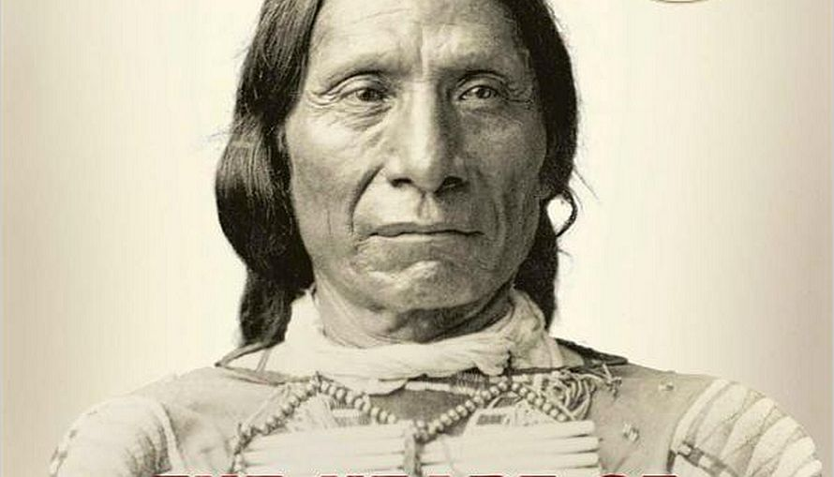
Peace Plans Fail
US Government planned to build a road through Sioux hunting ground.
1866 – Red Cloud and his followers ambushed US troops, killing them all.
US Indian Peace Commission decided Natives must assimilate.
Fort Laramie Treaty of 1868 – US Government agrees not to build the road and to abandon 3 forts and the Natives were allowed to live on a reservation with the support of the government.

Slide 16
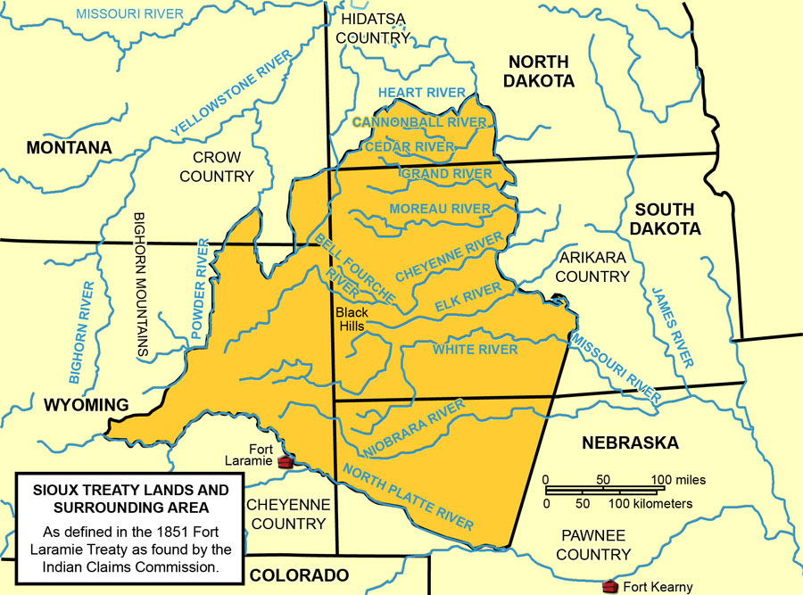

Slide 17
Key Events in the Indian Wars, 1861-1890

Slide 19
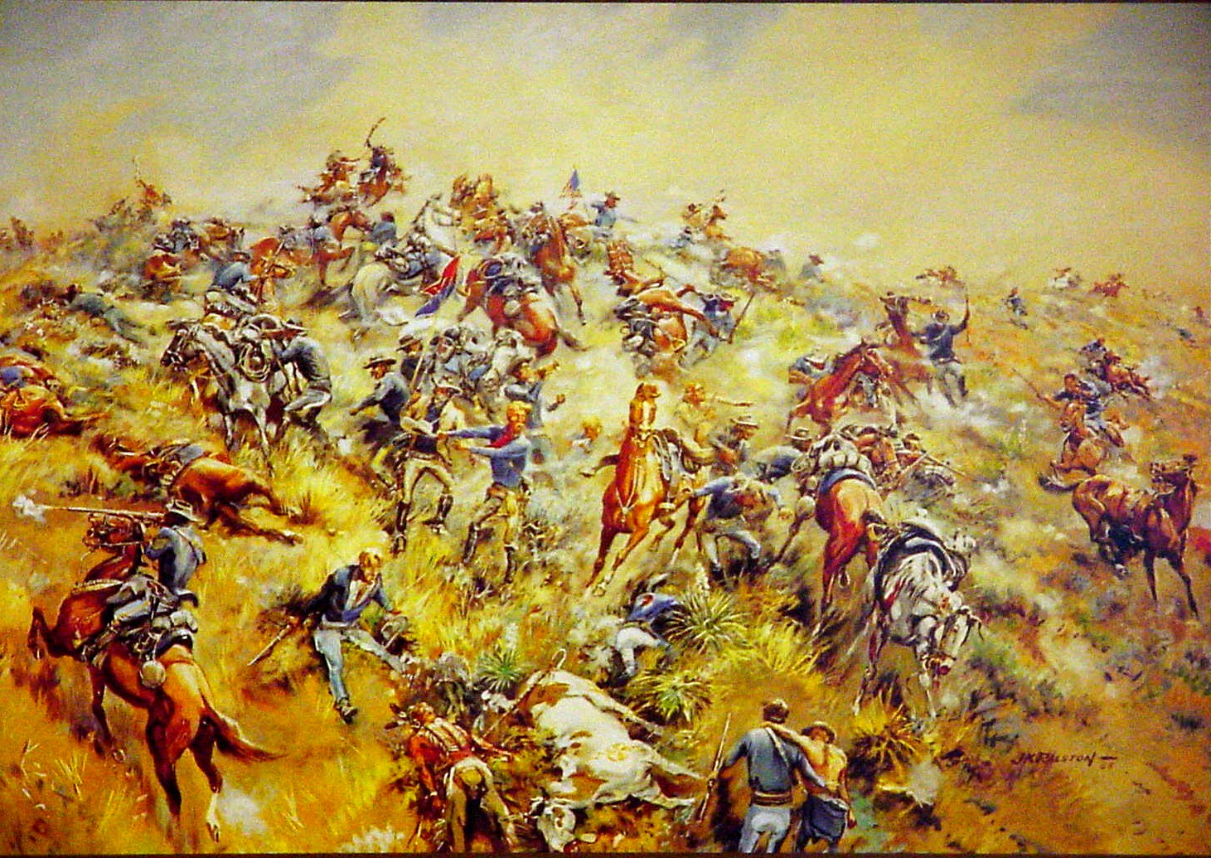

Slide 20
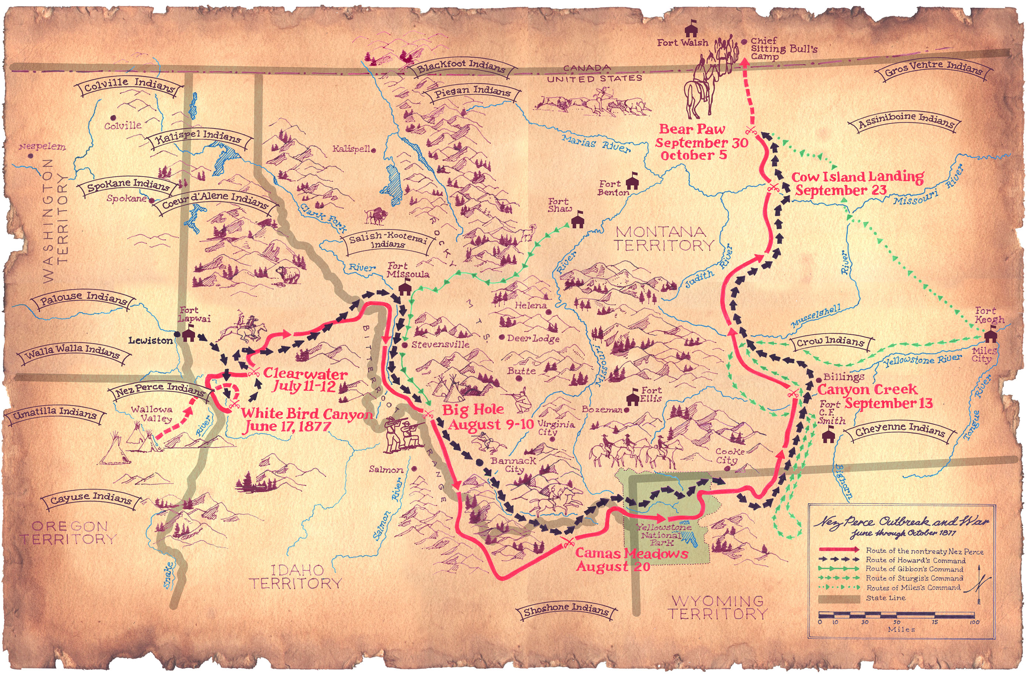

Slide 21
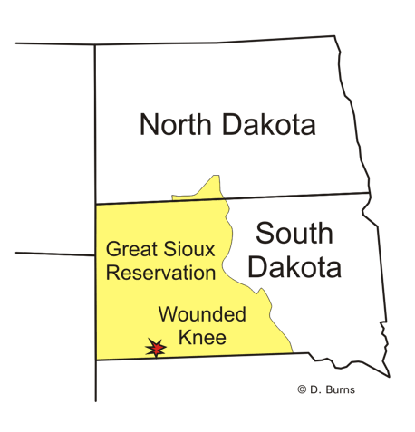
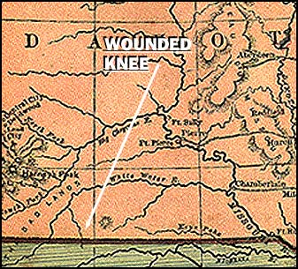
Massacre of Wounded Knee

Slide 22
Assimilation of the Native Americans
Reservation policy = failure!
The Dawes Act
Passed in 1871
“No Indian nation or tribe within the US would be recognized as an independent union, tribe or power with whom the United States may contract any treaty.”
Dawes General Allotment Act of 1877
Aka – Dawes Severalty Act
Replaced the reservation system with an allotment system.
Each family received 160 acre farmstead.
The land could not be sold or transferred from its original family for 25 years.
Families were encouraged to send their children to boarding schools and practice Christianity.

Slide 23
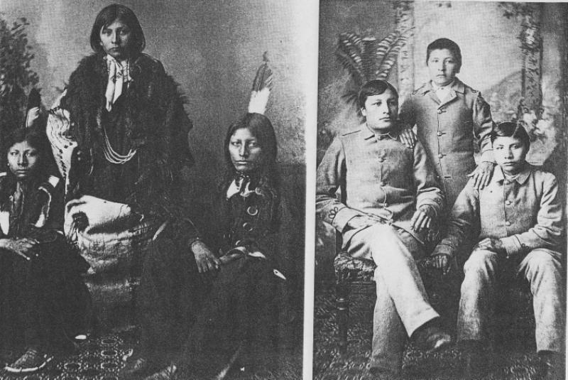

Slide 25
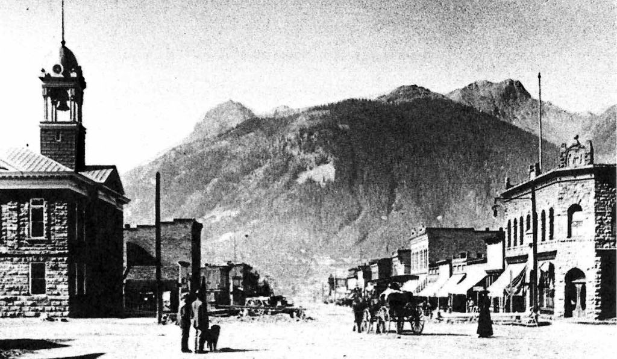
6.3 Transforming the West
Objectives
Analyze the impact of mining and railroads on settlements of the West.
Explain how ranching affected western development.
Discuss the ways various peoples lived in the West and their impact on the environment.
Key Terms
Vigilante
Transcontinental railroad
Land grant
Open-Range System
Homestead Act
Exoduster

Slide 26
Mining Towns
The first great “boom” of the West!
Gold & Silver
Ghost Towns
Towns that were quickly set up and were seen as “boomtowns” and then were abandoned.
*Leadville, Colorado
*Nevada City, Montana
Locations: From the Sierra Nevada to the Black Hills
Gold @ Pikes Peak in Colorado
Carson River Valley, Nevada
2 Types of people that came to the west for mining
Those to mine
Those to make money off the miners selling them needed supplies
Vigilantes punished law breakers and those that didn’t follow the rules of conduct and procedures for handing disputes.
As towns developed, marshals and sheriffs were created.
Wyatt Earp & Bat Masterson
Denver
Boise
Helena
*3 “boomtowns” that grew and diversified instead of becoming ghost towns.

Slide 27
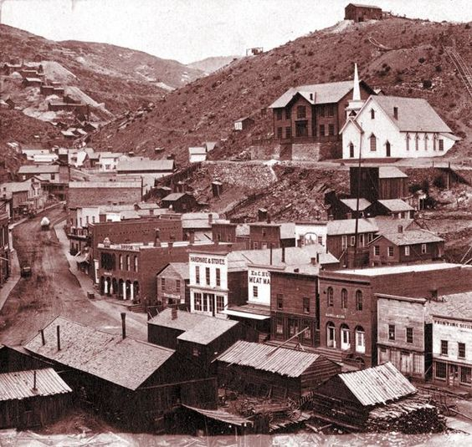
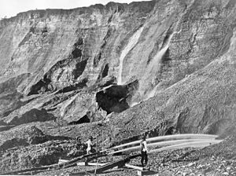
The Mining Industry
1st miners – individuals
Extracted the minerals from the soil or by a streambed
1870’s – Big companies move West
Began drilling and mining for the minerals underground
Began the major environmental issue of WATER and its uses.
Ruined the water for famers with the silt from their mining.

Slide 28
Railroads
Central Pacific
*laborers were from China
Union Pacific
*laborers were Irish Immigrants
Europe – railroads were owned by government.
US – build by private enterprises.
Supported by Congress in 2 ways:
$ in the form of loans
Giving Land Grants which gave them wide stretches of land to build the railroads.
1863 – Central Pacific begins in Sacramento, California
1863 – Union Pacific begins in Omaha Nebraska
1869 – Met at Promontory, Utah
Same year the Suez Canal was completed in Egypt!
Railroad labor
They were difficult and expensive to build.
Human cost considered High because it was so dangerous!!
“Starved” for laborers…. Had to recruit from China.
Little Regard for safefty!!

Slide 29
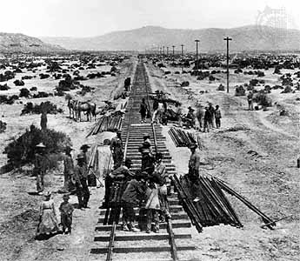
Railroads = Settlement
Tied the Nation together
Moved products & people
Spurred industrial development
Stimulated the growth of towns & cities
Intensified the demand for Indian land
Overwhelmed the Mexican American communities with white settlers
Created additional states
10 added between 1864 & 1896!
Statehood requirements:
*60,000 inhabitants

Slide 30
Ranchers & the Cattle Kingdom
Cow Towns
*RODEOS!
*Dodge City, Kansas
Cattle ranching was another boom due to the vast grasslands of the plains!
The end of Open Ranging
Invention of barbed wire!
Supply of beef exceeded demand!
Causing the price to drop!
Extreme weather!
Changed ranching as farmers begin to raise hay to feed their stocks.
The Vaqueros & Texas Longhorn
Mexicans in Texas had long raised the Longhorn and they roamed freely & were branded for identification.
The cowboy culture originated from the Mexican Vaqueros!!
Cowboys & Cattle Drives
Work was hard, dangerous, & lonely
They had to drive the cattle for hundreds of miles to the nearest train junction.

Slide 31
Farmers Settle on Homesteads
Necessity was the “mother” of Invention!
Barbed Wire
Plow
Grain Drill
Windmill
Dry-farming techniques
Morrill Act – granted land for agricultural colleges
Farmers were also looking for a better life in the West!
Railroads advertised from here to Europe of land for sale.
Homestead Act of 1862 – plots of 160 to anyone willing to live on the land for 5 years, dig a well, and build a road.
Exodusters – formers slaves who fled the South following the Civil War to Kansas and Oklahoma.
The Plains were treeless so homes were built from 3 foot sections of sod and stacked like bricks!
Space for only one door and one window.
DARK, DIRTY, & DINGY

Slide 32
Competition, Conflict, & Change
The El Paso Salt War - 1877
Mexican had mined salt from the beds of the El Paso Valley for years.
Americans arrived in 1870 and laid claim to the land.
Violence ensued and the result was the salt beds were no longer communal property.
Economic Rivalries
Miners, ranchers, & sheepherders conflicts often led to violence and sabotage.
Grazing cattle ruined farmers crops
Sheep gnawed the grass so close to the ground there was none left for the cattle.
Miners runoff polluted water for everyone.
Prejudices & Discrimination
The west had the widest diversity in the US
Fear & distrust in each other’s cultures caused tensions across the West.
Chinese immigrants and Mexican Americans were the largest target along with former slaves.
Ranchers belittled homesteaders by calling them “sodbusters”.

Slide 33
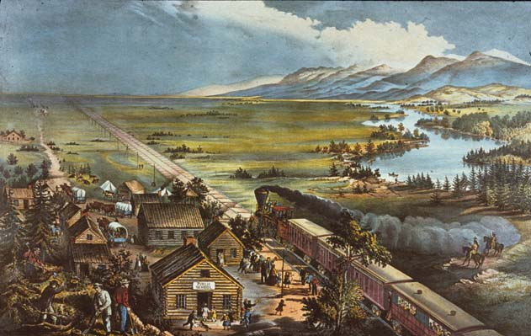
The Western frontier officially closes
1889 – Official major land rush occurred in Oklahoma when the federal government opened it.
4/22/89 – “boomers” gathered along the Oklahoma border ready to run and stake their claims!
“Sooners” had snuck into the territory early and took the best land.
1890 – US Census concluded there was no longer a square mile in the US that did not have at least a few white residents.
This marked the end of the Western Frontier land grab era.

