Slide 1
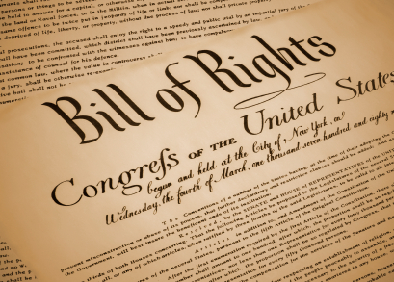
The Bill of Rights
Chapter 4

Slide 2
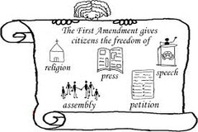
4.1 The First Amendment
Big Idea
The Constitution of the United States establishes and protects fundamental rights and liberties.
Key Terms
Civil liberties
Censorship
Petition
Slander
Libel

Slide 3
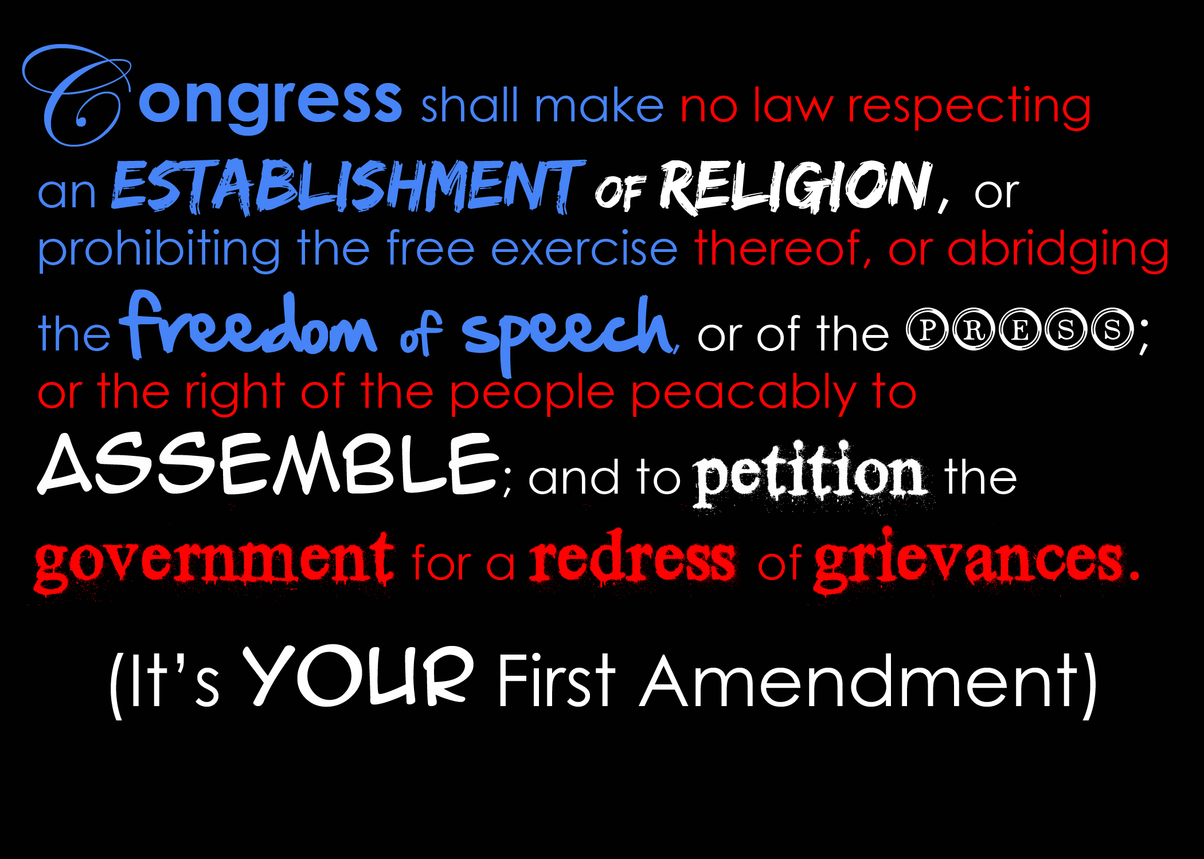
The 1st Amendment Freedoms
Civil Liberties – freedoms we have to think and to act without government interference or fear of unfair treatment.
“The Cornerstone of our democracy”
5 freedoms of the 1st Amendment
Freedom of Religion
Freedom of Speech
Freedom of the Press
Freedom of Assembly
Freedom to Petition

Slide 4
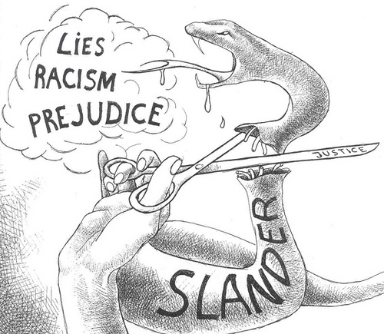
First Amendment Limits
All constitutional rights are limited. These limitations are necessary to ensure our other rights are protected.
Slander – spreading spoken lies
Libel – printing lies

Slide 5
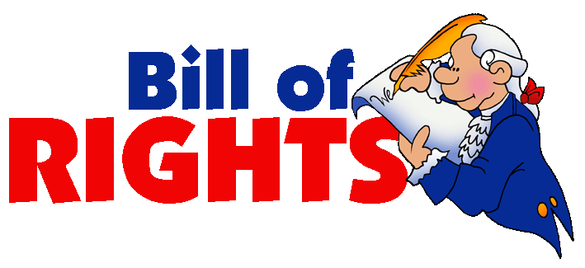
4.2 The Bill of Rights
Big Idea
The Constitution of the United States establishes and protects fundamental rights and liberties.
Key Terms
Search Warrant
Indictment
Grand jury
Double jeopardy
Due process
Eminent domain
Bail

Slide 6
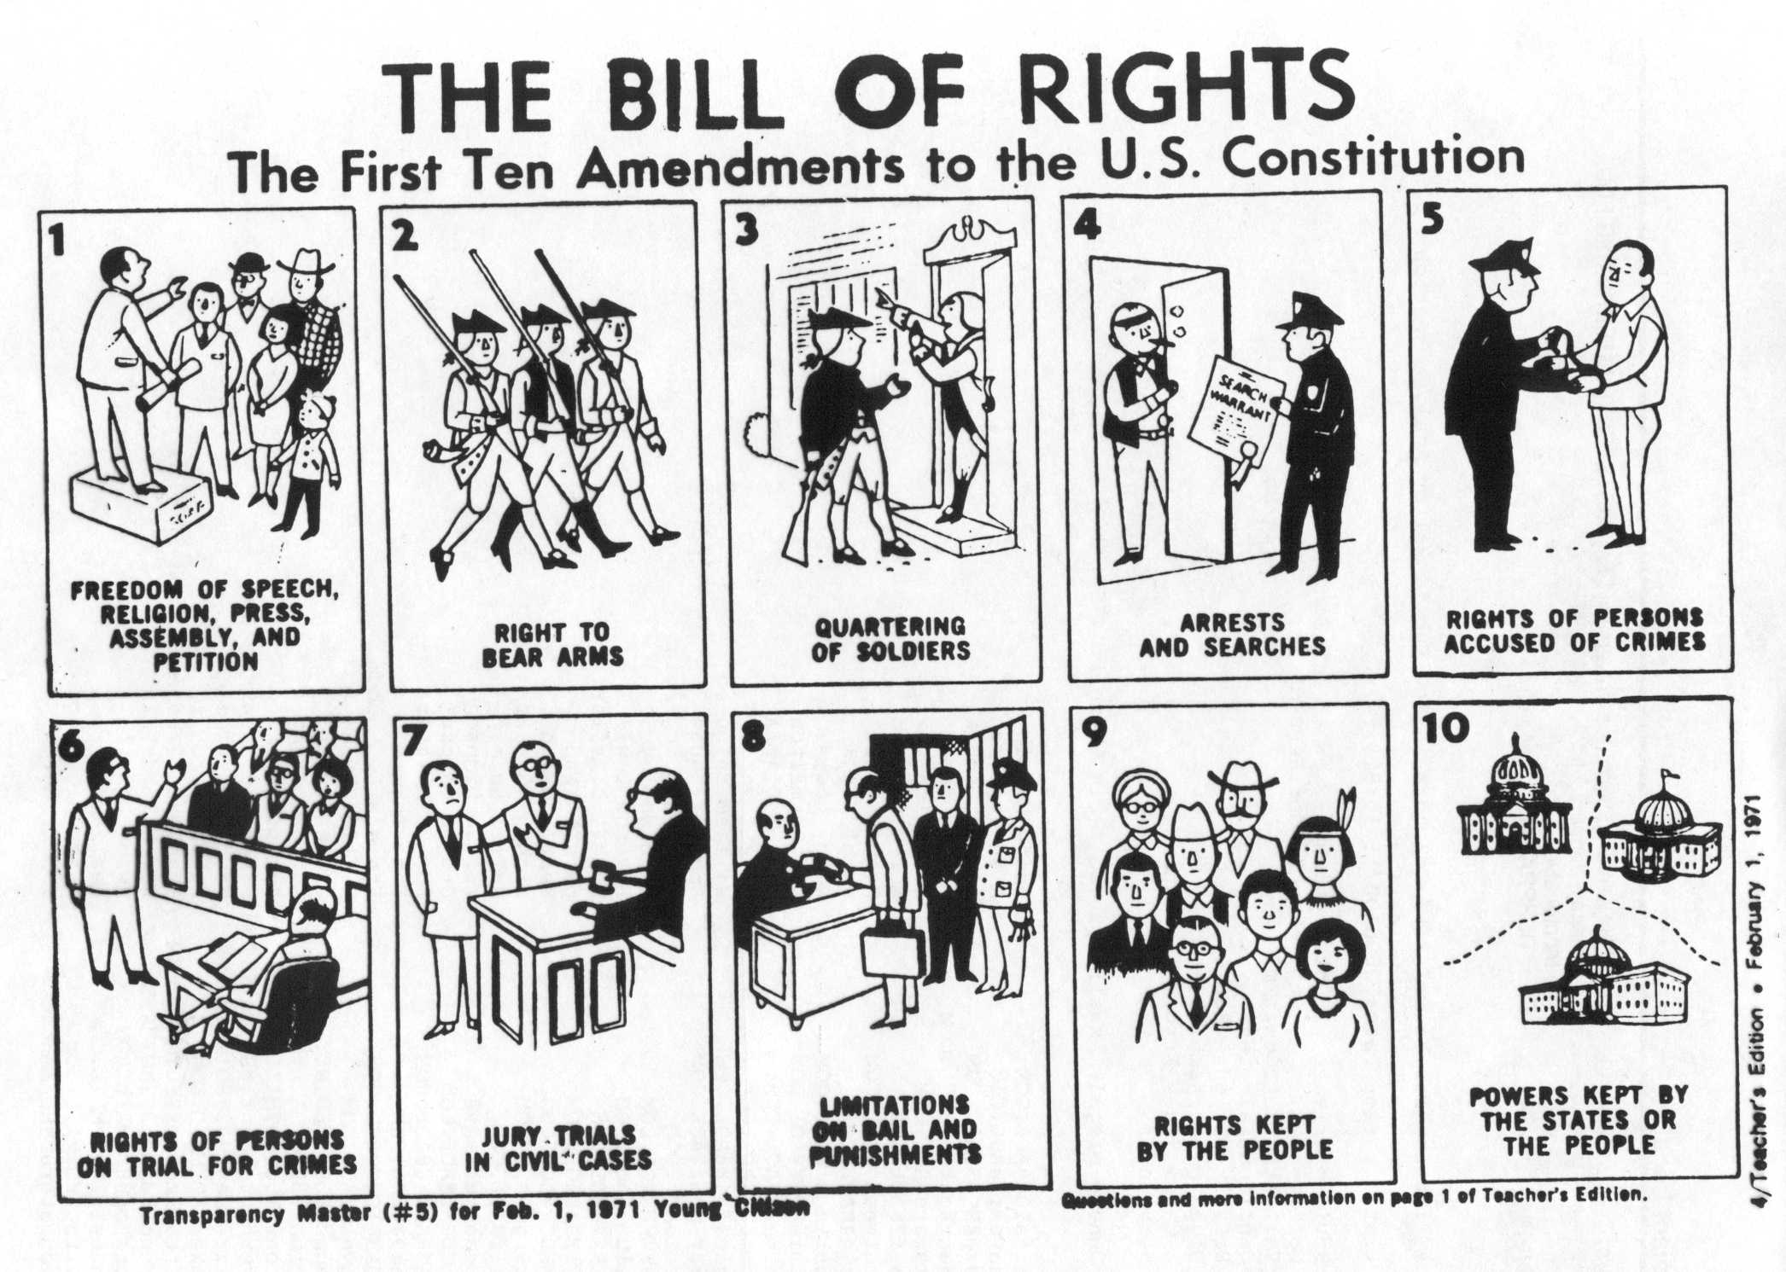

Slide 7
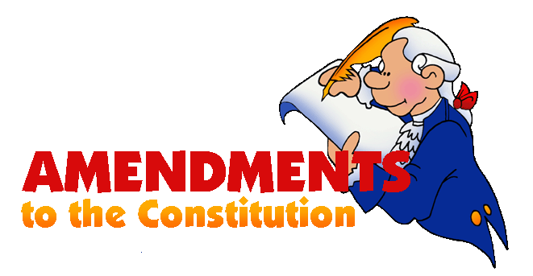
4.3 Extending the Bill of Rights
Big Idea
A constitution reflects the values and goals of the society that creates it.
Key Terms
Suffrage
Poll tax

